Slide 1
Transition work English
Welcome to English at Joyce Frankland Academy.
Over the course of Year 7 you will develop your skills in reading and writing. You will also have the opportunity to explore a range of exciting texts.

Slide 2
Reading and Writing
At Joyce Frankland we assess our students in two main areas – reading and writing.
Reading:
This area involves reading, understanding and responding to different types of texts. Your teachers will help you to:
Form opinions about a text
Select and analyse quotations to support your ideas
Understand and identify a range of language and structural techniques
Evaluate the skills of the author

Slide 3
Reading and Writing
At Joyce Frankland we assess our students in two main areas – reading and writing.
Writing:
This area involves crafting your own writing to suit a variety of purposes. Your teachers will help you to:
Use a range language techniques to develop description and creativity in your work
Structure your writing effectively to interest a reader
Develop and vary your vocabulary to fit the task
Evaluate the success of your writing and identify next steps

Slide 4
Transition Work:
In this presentation there will be a range of tasks for you to try, that require you to use both your reading, and writing skills.
It would be great if you could put your completed work into your ‘All about me booklet’ and bring it with you when you start school in September.
In your first couple of English lessons we will be exploring the theme of ‘New Beginnings’ and will then move on to study an adventure novel. The extract that you are going to read next is from a text that links to both of these themes.

Slide 5
‘Lord of the Flies’ by William Golding
Extract from CHAPTER ONE
(In this extract two boys meet on a desert Island after their plane has crashed, due to an attack)
The boy with fair hair lowered himself down the last few feet of rock and began to pick his way toward the lagoon. Though he had taken off his school sweater and trailed it now from one hand, his grey shirt stuck to him and his hair was plastered to his forehead. The jungle was a bath of heat. He was clambering heavily among the creepers and broken trunks when a bird, a vision of red and yellow, flashed upwards with a witch-like cry; and this cry was echoed by another.
"Hi!" it said. "Wait a minute!" The undergrowth was shaken and a multitude of raindrops fell pattering."Wait a minute," the voice said. "I got caught up.“
The voice spoke again. "I can't hardly move with all these creeper things." The owner of the voice came backing out of the undergrowth. The naked crooks of his knees were plump, caught and scratched by thorns. He was shorter than the fair boy and very fat. He came forward, searching out safe lodgments for his feet, and then looked up through thick spectacles. "Where's the man with the megaphone?"
The fair boy shook his head. "This is an island. At least I think it's an island. That's a reef out in the sea. Perhaps there aren't any grownups anywhere."
The fat boy looked startled. "There was that pilot. But he wasn't in the passenger cabin, he was up in front … Aren't there any grownups at all?“
"I don't think so." The fair boy said this solemnly; but then the delight of a realised ambition overcame him. He stood on his head and grinned at the fat boy. "No grownups!“
"That pilot … He must have flown off after he dropped us. He couldn't land here. He'll be back all right."
The fat boy shook his head. "We was attacked! When we was coming down I looked through one of them windows. I saw the other part of the plane. There were flames coming out of it." He looked up and down. "And this is what the cabin done.“
The fair boy reached out and touched the jagged end of a trunk. "What happened to it?" he asked.
"That storm dragged it out to sea. It wasn't half dangerous with all them tree trunks falling. There must have been some kids still in it."
He hesitated for a moment, then spoke again. "What's your name?"

Slide 6
Understanding The Extract: Answer the following questions in full sentences
How have the boys ended up on the island?
How are the two boys described?
What makes the ‘fair boy’ excited?
What happened to the jungle when the plane crashed?
Where is the wreckage of the plane now?

Slide 7
We are now going to look at a skill called ‘showing not telling’
This skill refers to whether information in a text is explicit or implicit. Explicit means it has been clearly stated in the text. Implicit means that we can make an assumption from clues given in the text.
Example:
The boy was tall.
The boy towered over me.
Which sentence is explicit?
Which sentence is implicit?
The first sentence is explicit because it tells the reader that the boy is tall.
The second sentence is implicit because it suggests, or shows us, that the boy is tall.

Slide 8
Showing not Telling:
By ‘telling’ you are simply supplying information by stating it. You might report that a character is “tall,” or “angry,” or “cold,” or “tired.”
‘Showing’ would paint a picture the reader could see in his/her mind’s eye.
‘Showing’ your reader allows them to understand the character on a deeper level. It makes your work more sophisticated and interesting to read.
Fill out the table below – what does each sentence suggest to the reader?
Showing Sentence | What does it suggest to the reader?
‘Fear spiked through me and my skin chilled.’
‘When he spoke, I could hear the smile in his voice.’
‘We crept the few metres home in a deep silence.’

Slide 9
Read this section from the extract again:
The boy with fair hair lowered himself down the last few feet of rock and began to pick his way toward the lagoon. Though he had taken off his school sweater and trailed it now from one hand, his grey shirt stuck to him and his hair was plastered to his forehead. All round him the jungle was a bath of heat. He was clambering heavily among the creepers and broken trunks when a bird, a vision of red and yellow, flashed upwards with a witch-like cry; and this cry was echoed by another. “Hi!” it said. “Wait a minute!” The undergrowth at the side of the scar was shaken and a multitude of raindrops fell pattering.
How does Golding show the reader that the weather is hot? ‘the jungle was a bath of heat’
How does Golding show the reader that the island is wild and difficult to cross?
How does Golding show the reader that animals live on the island?
How does Golding show the reader that the boy is not alone on the island?
Under each question write a quote which ‘shows’ the reader this information.
Question 1 has been done for you as an example.

Slide 10
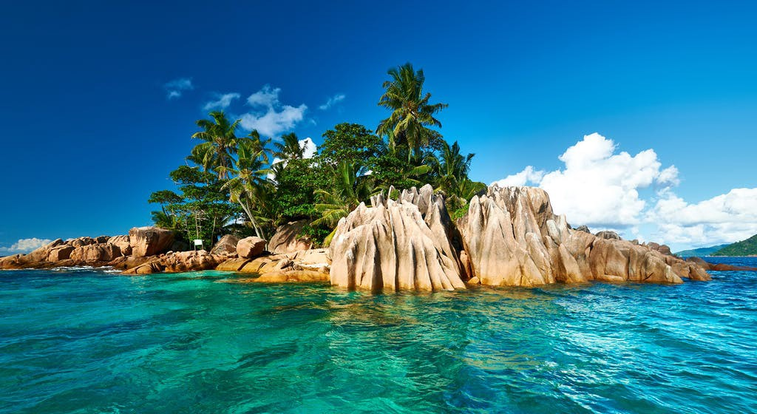
Design your own desert island
It must include:
Sandy beaches
Trees/jungle
Rocky cliffs
Wild animals
A fresh water source
Shelters where people can sleep
Bullet point some ideas or make a quick sketch.

Slide 11
Now that you have thought about what your island will look like. Write a detailed description of your island.
Challenge: try to include showing sentences in your description.
Use this image and the focus questions to inspire you.
There is also an example on the next slide.
How could you describe the weather on the island?
What noises do the palm trees make?
How could you describe the wildlife on the island?
What smells are in the air?
What sounds can you hear on the island?
What texture are the rocks? What do they feel like to touch?
How could you describe the colours of the ocean?
How does the island change as it goes from day to night?

Slide 12
My Island:
Jagged rocks pierce the waves like sharks teeth. Peacock coloured waters lap the golden beaches. Waving lazily in the warm breeze, palm trees whisper secrets of undiscovered treasures. Scorching sand slips between your toes as you eagerly explore this paradise. The air is thick with the smell of coconuts and the gentle hum of busy insects plays a soothing lullaby. The jungle is ablaze with colour, red and orange birds bicker in the trees. Vines curl like tentacles around the shelters where we sleep. As the sun begins to fade, cool breezes calm the island. Stars explode into the night sky like fireworks. The moon’s unblinking eye stands watch throughout the night.

Slide 13
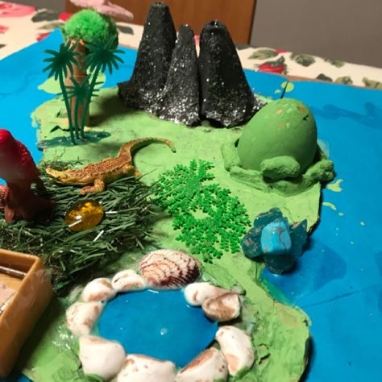
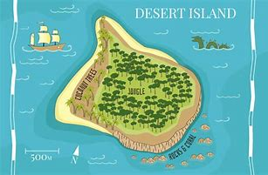
Optional Task
Draw a map or make a model of your island.

Slide 14
Thank you for taking the time to complete this presentation.
We hope you enjoy the summer holidays and look forward to meeting you all in September!

