Slide 1
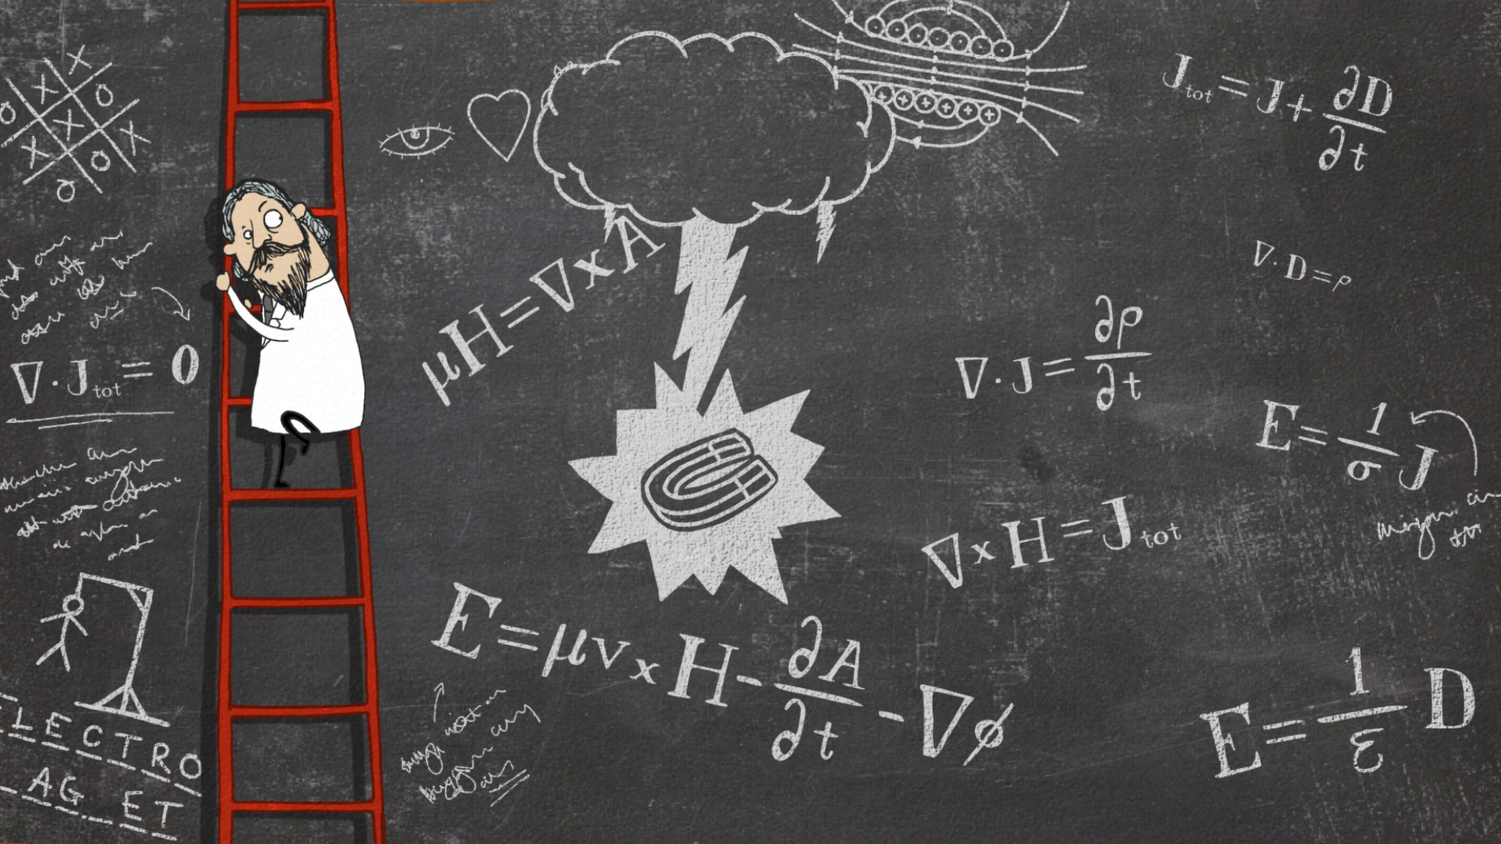
Welcome to Maths at Joyce Frankland Academy.

Slide 2
What equipment will I need to bring with me on my first day?

Slide 3
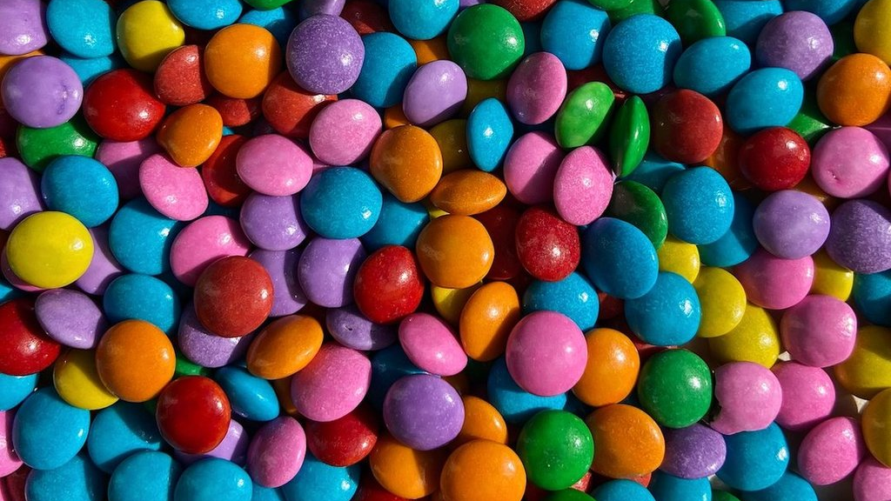
Transition task – Smarties investigation
Print slides 4 to 9.
Use the links on slide 10 to view short videos on the skills needed if you need to revise.
You will need a packet of Smarties to complete this task.
Have fun working through the tasks.
You can eat the Smarties when you are done. Yum!
Remember to bring your work with you to your first Maths lesson.
I look forward to meeting you in September.
Have a lovely summer holiday.
Mrs Gray

Slide 4
Transition task – Smarties investigation
You will need, 1 packet of smarties!
How many smarties are in the packet?
Colour | Tally | Frequency
Brown
Green
Pink
Purple
Orange
Yellow
Red
Blue
Complete the tally chart to show how many of each colour there is.

Slide 5
Transition task – Smarties investigation
Draw a bar chart to show the information in your tally chart.
What colour is the mode?
What is the median number?
What is the mean colour of Smarties? [Total ÷ number of colours]

Slide 6
Transition task – Smarties investigation
There are 8 smarties is a very small box.
There are 60 children in a group.
The teacher wants to give each child 5 smarties.
How many boxes of Smarties will she need to buy?
Show your working.

Slide 7
Transition task – Smarties investigation
What fraction/percentage of the smarties are brown, green, pink, purple, orange, yellow, red and blue?
Colour | Fraction | Percentage
Brown
Green
Pink
Purple
Orange
Yellow
Red
Blue

Slide 8
Transition task – Smarties investigation
One smartie weighs 1g. Work out the weight of each colour.
For example, if there are 9 pink smarties then, 9 pink smarties = 9g = 0.009kg
Colour | Weight in grams (g) | Weight in kilograms (kg)
Brown
Green
Pink
Purple
Orange
Yellow
Red
Blue
Remember:
1000g = 1kg

Slide 9
Transition task – Smarties investigation
Have a look at this table.
Student | Likes Smarties | Likes Chocolate
Frances | Yes | Yes
Thea | No | Yes
Annabel | Yes | No
Bethan | No | No
Write your name here:
Complete this two-way table using the information from the table above.
 | Likes Smarties | Doesn’t like Smarties
Likes Chocolate | Frances
Doesn’t like chocolate

Slide 10
Transition task – Revising the skills
Click on the buttons to view a short video to revise the skills you need to complete the tasks.
Tally charts
The Mean
Drawing bar charts.
Writing a fraction
The Mode
Converting fraction to percentages
The Median
Metric units of mass

